Slide 1
Periodic Trends- Ionisation Energy

Slide 2
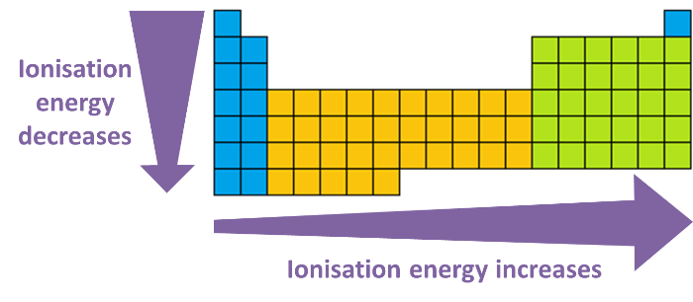
In this Smart Lesson you will learn to:
• Describe the property of atoms known as ionisation energy.
• Explain how an atom's ionisation energy can be estimated based on its position in the periodic table.

Slide 3
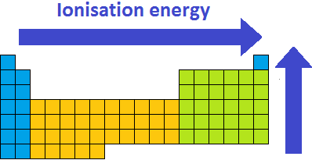
Ionisation energy is another property of an atom that displays a periodic trend.
The ionisation energy of an element is the amount of energy required to remove one valence electron from an atom in its gas form.
As expected this follows the same trend as electronegativity for the same reasons. The atoms with the highest ionisation energies are located at the top-right of the periodic table, including the noble gases.

Slide 4
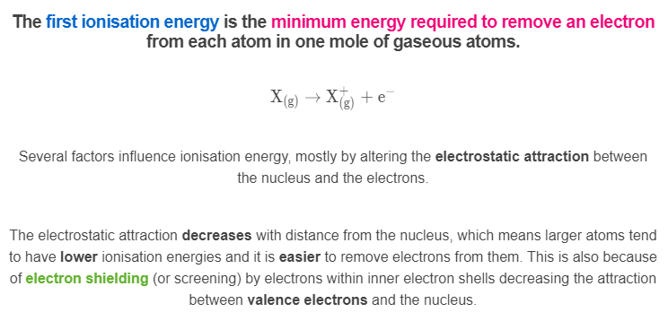

Slide 5
Periodic trends in ionisation energy.
Going down a group, the number of electron shells increases, which means that the valence electrons are found farther from the nucleus and the electrostatic attraction is weaker. This means it is easier to remove the first electron and the first ionisation energy decreases.
Going across a period, the number of protons in the nucleus increases, but the distance between the nucleus and valence shell is the same. This means the electrostatic attraction is stronger, making it harder to remove an electron and increasing the ionisation energy.

Slide 6
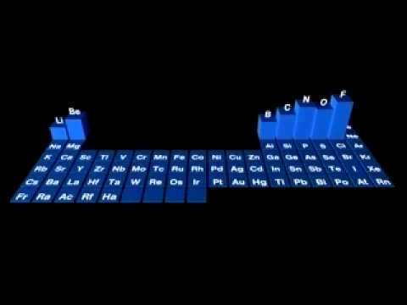

Slide 7
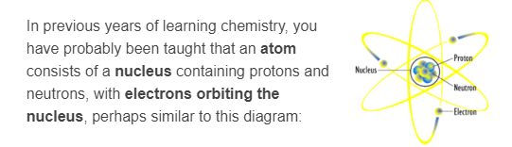
To understand ionisation energy you need to understand a bit about orbitals.
You now need to know that this idea is slightly wrong. Electrons are found in regions of space called orbitals, but this does not mean that they "orbit" the nucleus.
An atomic orbital is an energy level with a certain shape and size, in which an electron is highly likely to be found at any point in time. Energy level diagrams are used to describe the energy of atomic orbitals and the location of the electrons.

Slide 8
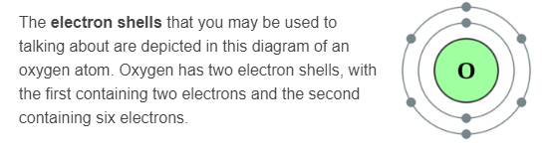
Electron shells and orbitals.
The innermost electron shells have the lowest energy, and the energy increases as shells get further away from the nucleus. Remember:
- | The first electron shell can contain only two electrons.
- | The second electron shell can contain up to 8 electrons.
- | The third electron shell can contain up to 18 electrons.
Within each electron shell, there are subshells, which are groups of atomic orbitals. There are four different types of subshell, known as the s,p,d, and f subshells. Each subshell has a different number of atomic orbitals that make it up, and the atomic orbitals in each subshell have characteristic shapes.

Slide 9
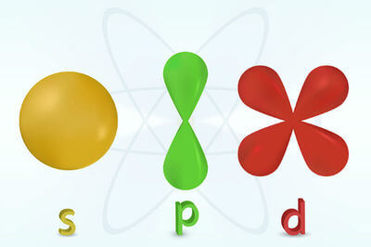
The s, p and d orbitals have the shapes shown in the diagram below.
What you do need to know is that each atomic orbital can hold two electrons. There is always one s orbital, three p orbitals, five d orbitals, and seven f orbitals, but not every energy level (shell) contains every type of orbital, as shown in the diagram below.

Slide 10
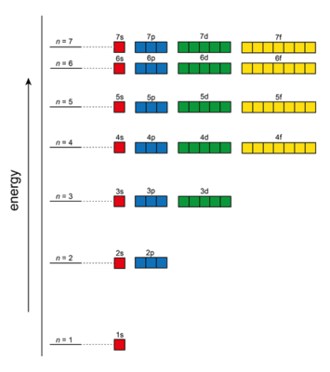
The first energy level (shell) contains only one s orbital, and therefore can contain only two electrons. The second energy level contains one s orbital and three p orbitals, and can therefore contain up to 8 electrons. The third energy level contains one s orbital, three p orbitals, and five d orbitals, and can therefore contain up to 18 electrons.

Slide 11
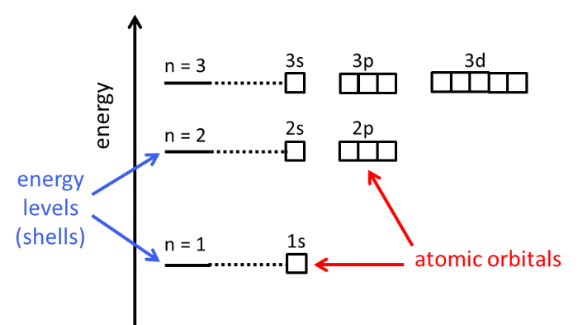
In an energy level diagram, like the one shown below, energy increases up the y axis.
Atomic orbitals are depicted by small boxes, and each box can only contain two electrons. Electrons are depicted by arrows, with one pointing up and one pointing down in each orbital (box).
The orbitals are labelled to indicate both the energy level and the subshell or atomic orbital level. For example, the s orbital in the first energy level is called the 1s orbital. The p orbitals in the second energy levels are called the 2p orbitals. Electrons always fill orbitals starting from the lowest energy orbital (1s).

Slide 12
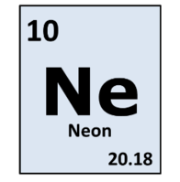
So how do you represent electrons in the orbitals?
Let's look at the example of a neon atom.
It has 10 electrons. Starting with the lowest energy levels, there will be 2 electrons in the 1s orbital, 2 electrons in the 2s orbital and 6 electrons in the 2p orbital.
This is written as 1s² 2s² 2p⁶
The superscript number is the number of electrons in the orbital.

Slide 13
Ionisation energy also changes between the different kinds of orbital.
A p orbital has a lower ionisation energy than an s orbital.
The shape of p orbitals means they have a slightly higher energy and so an electron in a p orbital is located further from the nucleus than one in the corresponding s orbital. This makes the electrostatic attraction weaker and thus makes it easier to remove an electron from the p orbital.
This can be seen in the graph below when comparing boron (B) and beryllium (Be). Beryllium has an electron configuration of [He]2s², meaning it has 2 electrons in the 2s orbital, while boron's is [He]2s²2p¹, meaning it has 2 electrons in the 2s orbital and 1 electron in the 2p orbital. Boron has a lower ionisation energy even though it has more protons in its nucleus.

Slide 14
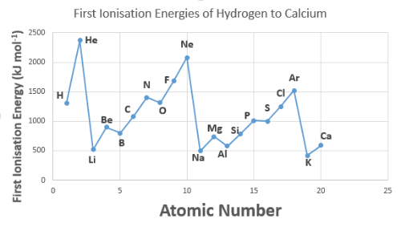

Slide 15
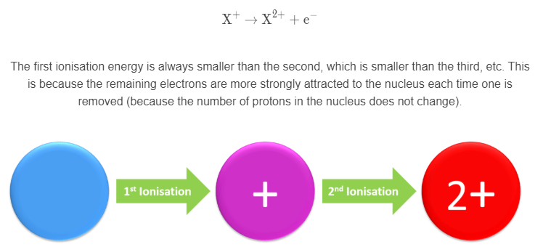
Second ionisation energy.
Just like the first ionisation energy is the energy required to remove the first electron from a neutral atom, the second ionisation energy is the energy required to remove the second electron from the X⁺ ion.

Slide 16
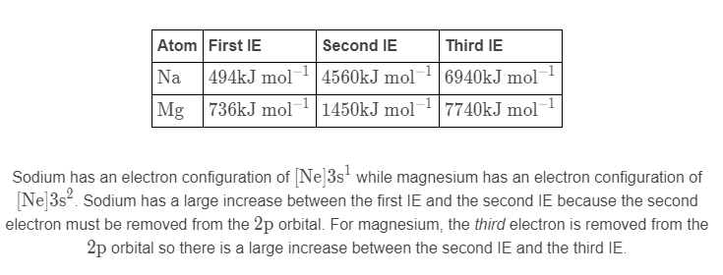
Each time an electron shell is removed, the next ionisation energy becomes much greater.
The electrostatic attraction is much stronger for electrons closer to the nucleus. For example, compare sodium and magnesium:

